Slide 1
TRANSISTOR BIASING

Slide 2
•Transistor is a solid state device whose operation depends upon the flow of electric charge carriers within the solid.
•Current controlled device
•Transistor is called BJT
APPLICATION
•Control system
•Satellites and Mobile phones
•Communication System
ADVANTAGE
•Compact Size
•Light weight
•More resistive to shock and vibrations
•Low operating Voltage
•High Operating Efficiency

Slide 3
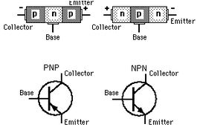
JUNCTIONS
•Emitter Base Junction
•Collector Base Junction
TERMINALS
•Emitter - heavily doped. Supply majority charge carriers.
•Base – lightly doped. Pass most of the carriers into collector
•Collector –moderately doped. Collect majority carriers.
The FBed EB Jun offers low resistance to emitter current whereas CB jun which is RBed offers High resistance to collector current.

Slide 4
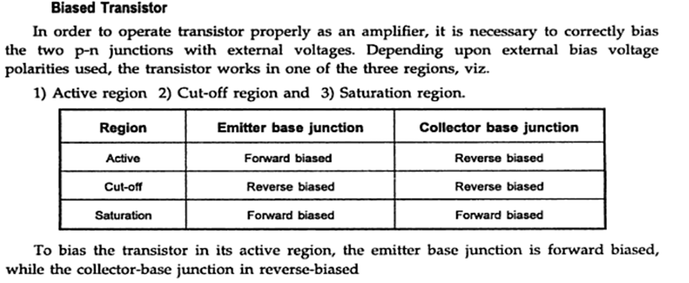

Slide 5
NEED FOR BIASING
The purpose of DC biasing of a transistor is to obtain certain DC collector current at a certain DC collector voltage in order to produce distortion free output.
The values of current and voltage are named as Q point or Quiescent point or DC conditions
A transistor can be biased with the help of battery.

Slide 6
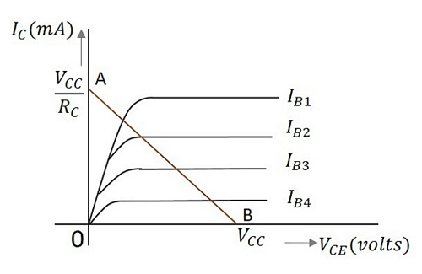
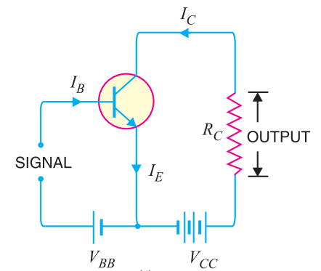
TRANSISTOR LOAD LINES
It is the line on which the operating point moves when AC signal is applied to the transistor.
Apply KVL on o/p section
Vcc = IcRc+ V_{CE} ------(1)
V_{CE} = Vcc-IcRc -----(2)
Ic = Vcc-V_{CE}
Rc
When Vce = 0 , Ic = Vcc/Rc from eqn(1)
Ic = 0 Vce=Vcc

Slide 7
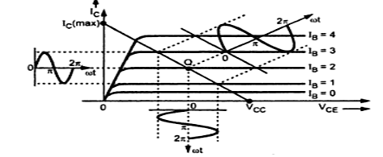
If we join two points A & B , DC load line is obtained.
Q point:-It is apoint on the dc load line which
represents dc collector emitter voltage Vce and
collector current Ic in the absence of AC signal.

Slide 8
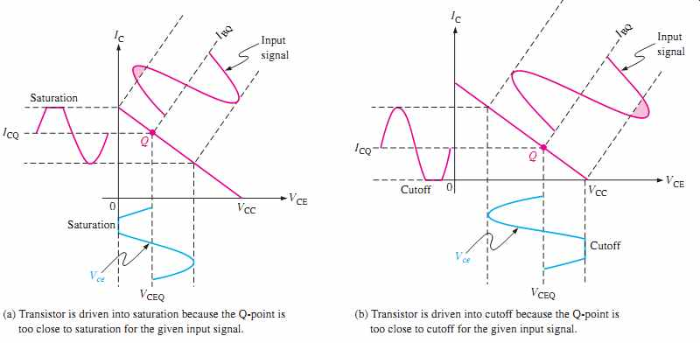

Slide 9
Stabilization
Only the fixing of a suitable operating point is not sufficient but it is also to be ensured that the operating point remains stable.
It does not shift due to change in temperature or due to variations in transistor parameters.
The maintenance of the operating point stable is known as stabilization

Slide 10
FACTORS RESPONSIBLE FOR SHIFT IN Q POINT
There are two reasons for the operating point to shift
The transistor parameters are temperature dependent.
The parameters (such as β) change from unit to unit

Slide 11
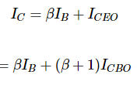
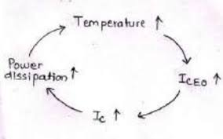
FACTORS RESPONSIBLE FOR SHIFT IN Q POINT
Temperature dependence
Flow of current in the collector circuit produces heat at the collector junction and this increases the temperature.
More minority carriers are generated in base-collector region and then the leakage current I_{CBO} increases
When I_{CBO} increases, then I_{CEO} also increases, which in turn increase the collector current. This further raises the temperature of the collector – base junction and the whole cycle repeats again.
The excess heat produced at the junction may even burn the transistor. This situation is known as thermal runaway.

Slide 12
β dependence
If we replace the transistor then due to variations in β, collector current Ic will vary and hence operating point is shifted.
Requirements of a biasing circuit
To establish the operating point in the centre of active region of output characteristics so that operation of transistor always remains in active region with applied input signal.
To make the operating point independent of temperature variations.
To stabilize the operating point against transistor parameters

Slide 13

STABILITY FACTOR
The rate of change of collector current IC with respect to the collector leakage current ICO at constant β and IB is called Stability factor.
Any change in collector leakage current changes the collector current to a great extent. The stability factor should be as low as possible so that the collector current doesn’t get affected. S=1 is the ideal value.

Slide 14
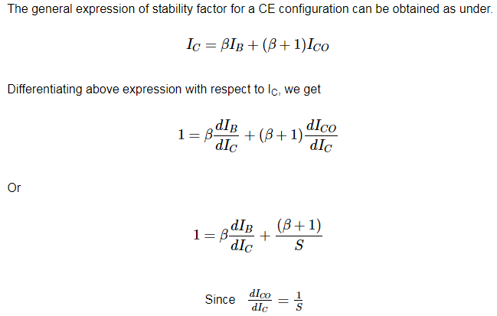
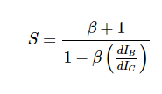

Slide 15
METHODS OF TRANSISTOR BIASING
The commonly used methods of transistor biasing are
Fixed bias/Base Resistor method
Collector to Base bias
Biasing with Collector feedback resistor
Self bias/Voltage-divider bias
All of these methods have the same basic principle of obtaining the required value of IB and IC from VCC in the zero signal conditions.

Slide 16
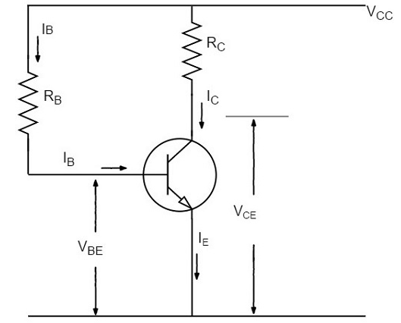
FIXED BIASING/BASE RESISTOR METHOD
In this method, a resistor RB of high resistance is connected in base, as the name implies. The required zero signal base current is provided by VCC which flows through RB. The base emitter junction is forward biased, as base is positive with respect to emitter.
The required value of zero signal base current and hence the collector current (as IC = βIB) can be made to flow by selecting the proper value of base resistor RB. Hence the value of RB is to be known. The figure below shows how a base resistor method of biasing circuit looks like.

Slide 17
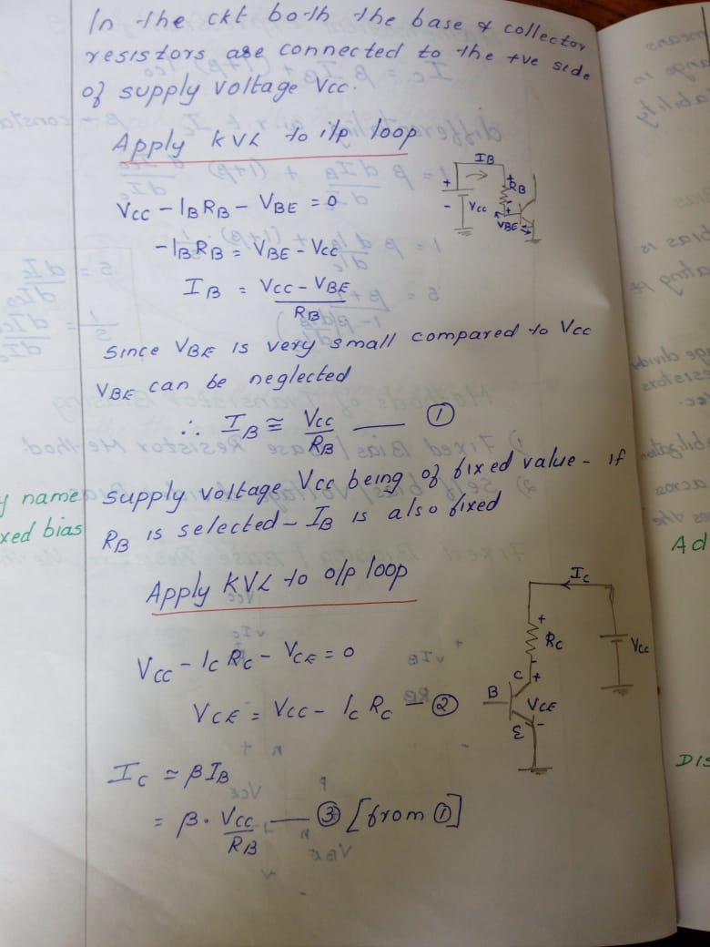
Apply KVL to input loop
Vcc-I_{B}R_{B}-V_{BE} = 0
-I_{B}R_{B} = V_{BE} - V_{CC}
I_{B} = V_{CC} - V_{BE}
R_{B}
Since VBE is very small compared to VCC , VBE can be neglected
I_{B} = V_{CC}/R_{B} Supply voltage Vcc being of fixed value. If R_{B} is selected I_{B} is also fixed. Hence the
I_{C}= 𝛃Vcc …….(1) name fixed bias
R_{B}

Slide 18
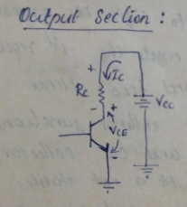
Apply KVL to o/p loop
Vcc-I_{c}R_{C}-V_{CE} = 0
V_{CE} = Vcc - I_{c}R_{C ………} (2)
Equation (1) and (2) determines Q point
The value of Ic and Vce depend on value of 𝛃 which depends strongly on temperature. So Q point will change with change in 𝛃 due to variation in temperature.
Equation 2 and 3 determines the Q point.
The value of Ic and Vce depend on value of

Slide 19
Stability Factor for Fixed Biasing Circuit
In Fixed bias dI_{B}/dIc = 0 because I_{B} is independent of Ic.
S = 1+𝛃
Merits:
· It is simple to shift the operating point anywhere in the active region by merely changing the base resistor (RB).
· A very small number of components are required.

Slide 20
Demerits:Why fixed bias is seldom used?
Any rise in temperature results in rise of I_{CBO} and I_{CEO}.Hence Ic rises resulting in increase in collector junction temperature. This is a cumulative process and the collector current goes on increasing. Therefore the operating point is not stable.
When the transistor is replaced with another one, considerable change in the value of β can be expected. Due to this change the operating point will shift.

Slide 21
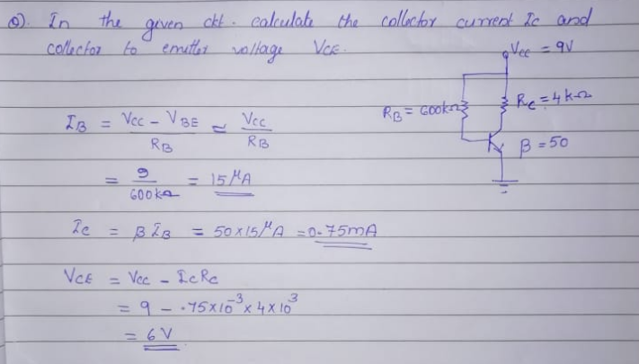

Slide 22
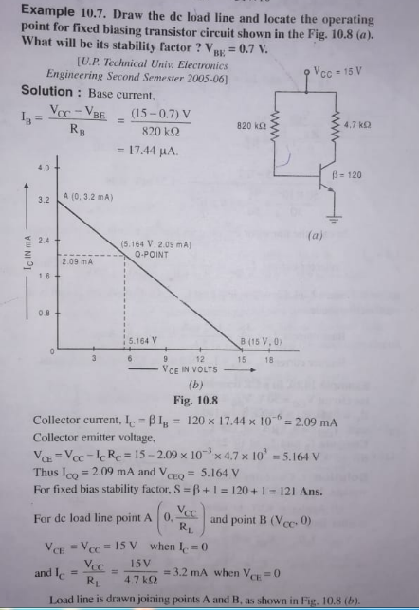

Slide 23
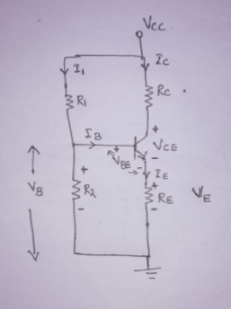
SELF BIAS OR VOLTAGE DIVIDER BIAS
It is a type of dc circuit in which the operating point is independent of transistor current gain 𝛃
The name voltage divider is formed by resistors R1 and R2 across Vcc.
R_{E} provides stabilisation
The voltage drop across R2,forward biases the EB junction.
To find Q point(V_{CE},I_{C})
Assume that the base current I_{B} is very small compared to the currents in R₁ & R₂
I₁≈ I₂ >> I_{B}
If current flowing through R₁ is I₁, since I_{B} is very small, then the current flowing through R2 can be assumed to be I₁.
I₁ = Vcc/(R1+R2)

Slide 24
Voltage across R₂ is V_{B} = I₁.R₂ = Vcc R₂
R1+R2
Apply KVL to base emitter loop
V_{B} - V_{BE} - V_{E} = 0
V_{E} = V_{B} - V_{BE -------- (A)}
Emitter current I_{E} = V_{E}/R_{E} = V_{B} - V_{BE}
R_{E}
Collector current I_{C}⩰ I_{E} = V_{B} - V_{BE}
R_{E} ......... (1)
Apply KVL to collector side
Vcc - IcRc - V_{CE} - I_{E}R_{E} = 0
V_{CE} = V_{CC} - I_{C}(R_{C}+R_{E}) ............. (2)
.

Slide 25
From (1) AND (2) it is clear that Q point is independent of 𝛃. So this method is widely used
How R_{E} provides excellent stabilization
From (A) V_{BE} = V_{B} - V_{E} ........(3)
If Ic increases due to rise intemperature, the voltage drop emitter resistance R_{E} increases. But the voltage V_{B} = Vcc.R2
R₁+R₂ ie V_{B} is independent of collector current, therefore V_{BE} decreases (3) .
This will decrease the value of I_{E} which inturn reduce the value of Ic to its original level . I_{C}⩰ I_{E} = V_{B} - V_{BE}
R_{E}
Thus R_{E} provides thermal stability.

Slide 26
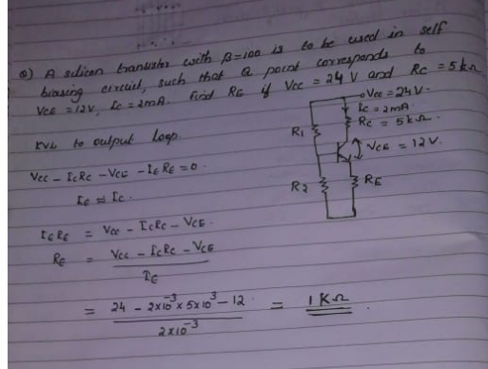

Slide 27
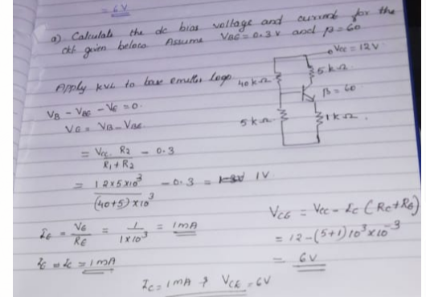

Slide 28
